Slide 1


Predictive Analytics Project
Healthcare Prediction
(Stroke & Diabetes)
By: Shermaine, Shi Min,
Zhang Xiang & Rawtbhik
Notes:
shermaine

Slide 2
Contents
01
Goal & Purpose
02
Stroke Prediction
03
Diabetes Prediction
Our business goal and the purpose of topic
Notes:
shermaine

Slide 3
Approach
01
Data Collection
Data Understanding
02
Where we got our data and what it includes
Errors in our dataset
04
Model & Evaluate
03
Data Preparation
Cleaning, Balancing and Partitioning our Dataset
Modelling Cleaned Dataset & Evaluate
Notes:
shermaine

Slide 4

Introduction
Shi Min
Stroke
Shermaine
Stroke
Zhang Xiang
Diabetes
Rawtbhik
Diabetes
Notes:
shermaine

Slide 5

01
Goal & Purpose
Notes:
shermaine

Slide 6
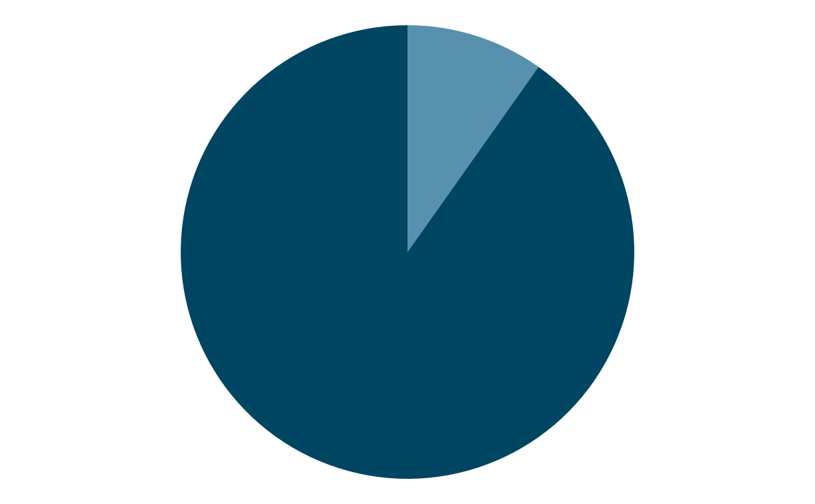

Current Situation
Singapore’s healthcare industry reached..
9.8%
1 in 210
attrition in 2021, which was a huge increase from 6.8% in 2020. As a result of the attrition, our healthcare industry is severely understaffed.
patients face delayed treatment due to misdiagnosis OR not seeking help after first onset symptoms.
References: Healthcare Workers Singapore, Human Errors & Prevention in Healthcare
Notes:
Shermaine
https://www.channelnewsasia.com/cna-insider/why-healthcare-workers-singapore-hospitals-resignations-2647746
https://www.ncbi.nlm.nih.gov/pmc/articles/PMC2656002/
https://www.ncbi.nlm.nih.gov/pmc/articles/PMC8562433/

Slide 7
bjective
Develop categorical predictive models of 80% accuracy to detect common health problems in our global population and the factors contributing to those health issues.
Pinpoint factors associated with major health problems, so that potential patients will be aware of them and take preventive measures to avoid becoming victims of such problems.
Help predict health problems more accurately through algorithms, thereby reducing healthcare stress, delayed detection and human error.
Notes:
shermaine

Slide 8

Stroke Prediction

Slide 9

02a
Data Collection

Slide 10
Selected Dataset
Our stroke dataset is retrieved from Kaggle, a public data repository for datasets. As part of McKinsey & Company's healthcare hackathon challenge in 2018, they published this dataset of electronic health records, which is now publicly available on Kaggle.
What is Electronic Health Record (EHR)? → a repository of patient information, consisting of patient’s vitals, diagnoses, and medical exam results, keyed by 4 qualified physicians.
Dataset contains: 5110 EHR observations with 12 attributes. The target is a binary value, indicating whether or not the patient has suffered a stroke.
Input attributes in EHRs include patient identifiers, gender and age, along with binary information of hypertension, heart disease, marital status, occupation, place of residence, average glucose level, body mass index, and smoking status.
Notes:
shermaine

Slide 11

02b
Data Understanding
Notes:
shermaine

Slide 12
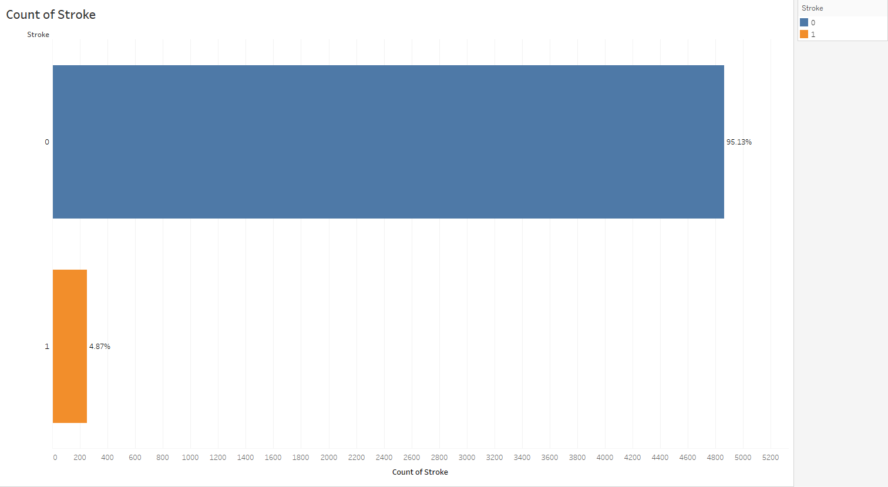
Data Understanding
Dataset Unbalanceness
About 95% of our raw data states that an individual does not have a stroke, which is our target variable.
With this result, our model is proven to be highly unbalanced, and requires data balancing in the further steps.
Notes:
shermaine

Slide 13
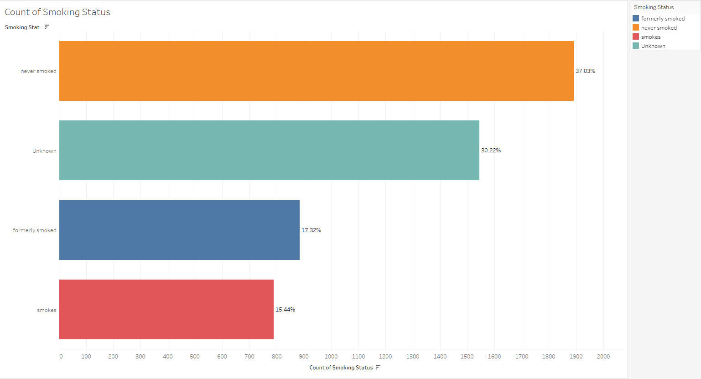
Data Understanding
Unknown Values
There are unknown smoking values.
Due to the subjective nature of smoking and that unknown values do not provide us with any information, we have decided to remove smoking’s "unknown" values.
Notes:
shermaine

Slide 14
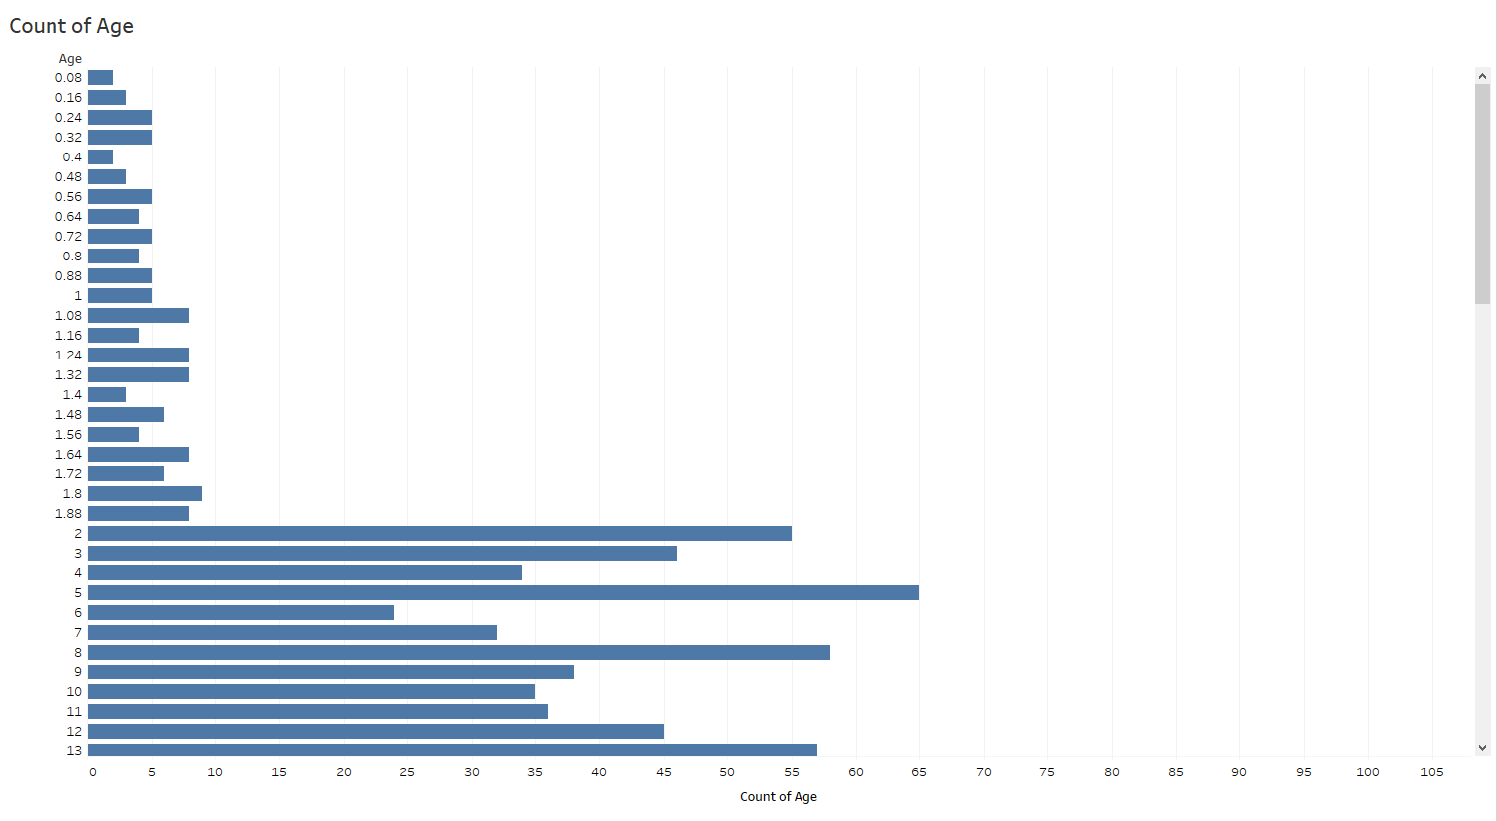
Data Understanding
Incorrect Values
Age column contains decimal values.
Dataset did not include an age decimal data explanation and we are uncertain whether it is a wrong value or if it signifies something else.
Notes:
shimin

Slide 15
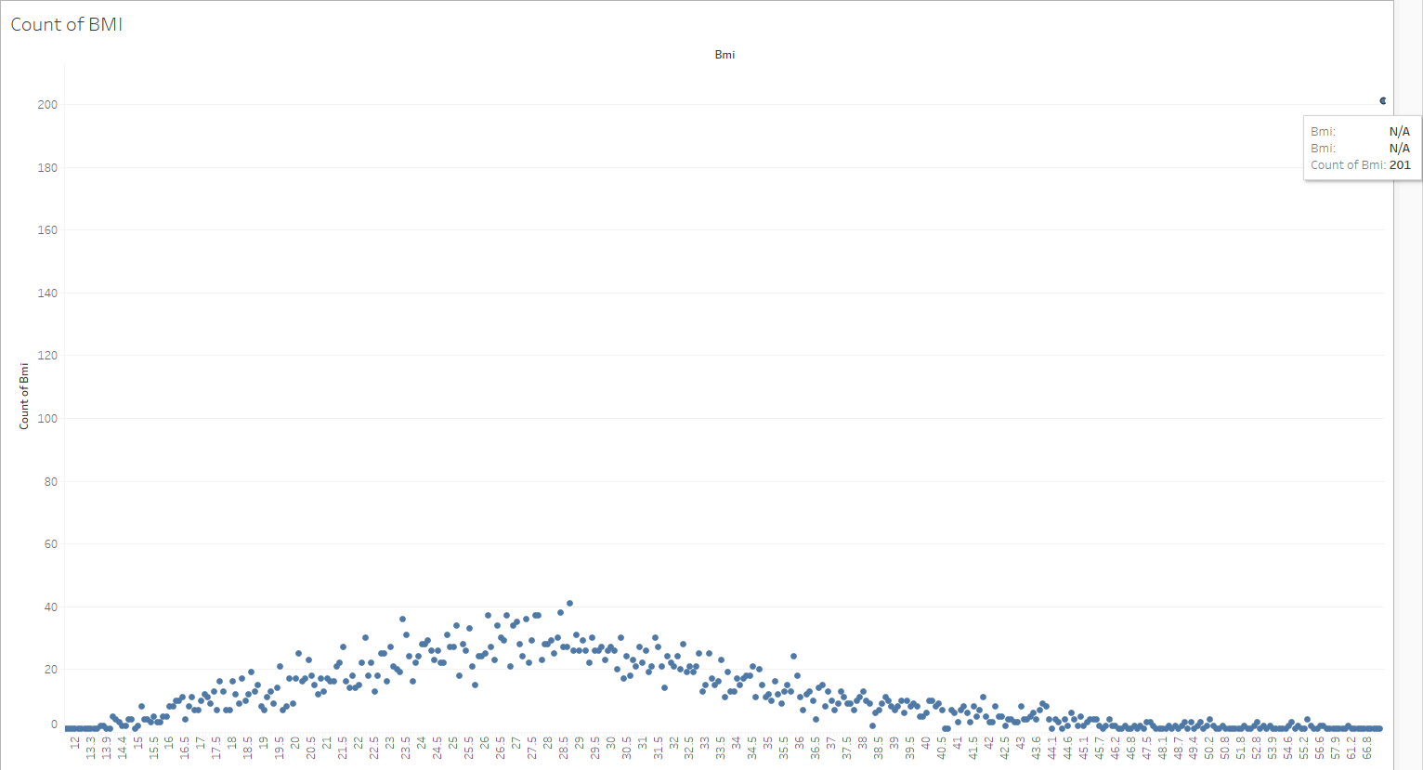
Data Understanding
Detecting Anomaly
Scatter plot in also shows that there is an anomaly in bmi, consisting of 201 missing values.
Impute all N/A values from the bmi, using the mean values.
Notes:
shimin

Slide 16
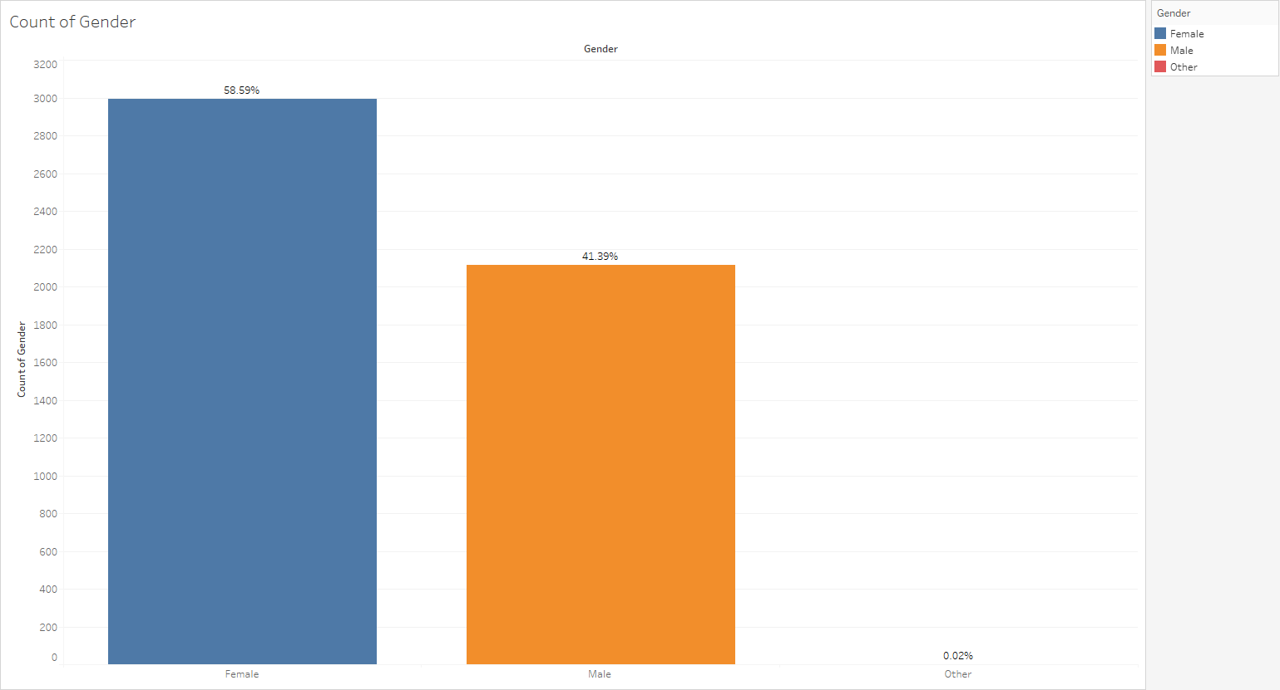
Data Understanding
Detecting Anomaly
Gender consists of one "other" value.
No further explanation in the dataset, and as there was only one value, we decided to remove it
Notes:
shimin

Slide 17
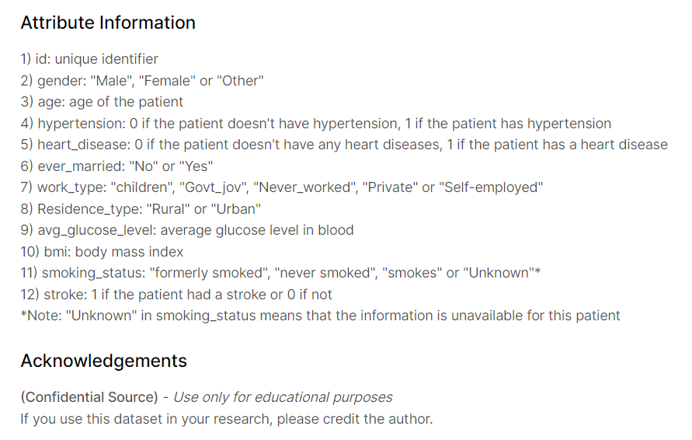
Data Understanding
Data Privacy Ethics
Dataset contains unique identifiers
Dataset contains explicit identifiers
High chance of individual personal data breached
Notes:
Shimin hence should be anonymised can say tat

Slide 18

03
Data Cleaning

Slide 19
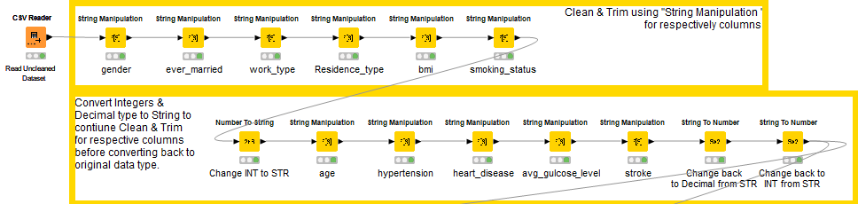
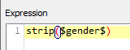
Data Cleaning
Clean & Trim
Cleanliness & integrity of the dataset
Remove white and leading spaces
Notes:
shimin

Slide 20
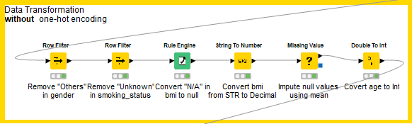
Data Cleaning
Data Transformation
Remove dirty values
Notes:
shimin

Slide 21
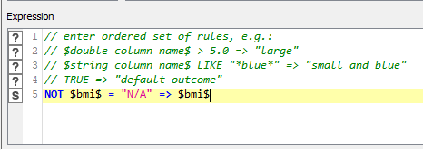
Data Cleaning
Data Transformation
Converted N/A values to nulls
If BMI != “N/A”, BMI = original value, else = null
Converted bmi column data type from string to decimal (double)
Notes:
shimin

Slide 22
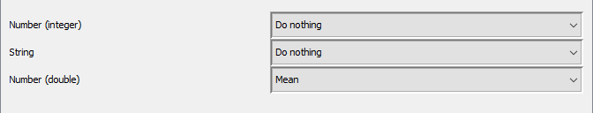
Data Cleaning
Data Transformation
Impute null values
Uses mean value of bmi column
Notes:
shimin

Slide 23
Data Cleaning
Data Transformation
Age outliers removed during removal of smoking_status “Unknown”
Notes:
shimin

Slide 24
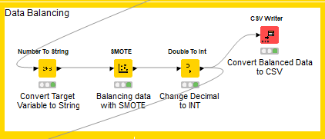
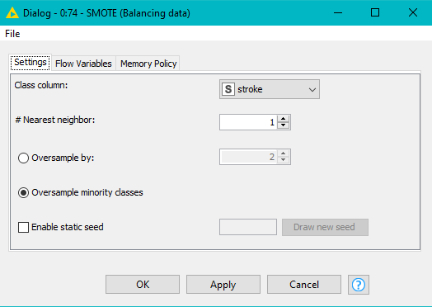
Data Cleaning
Balancing
Used KNIME’s “SMOTE” node to balance data.
Oversampled by the minority class.
Produced a total of 6726 rows, with a 50:50 amount on our target variable.
Notes:
shermaine

Slide 25
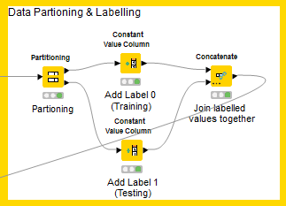
Data Cleaning
Partitioning
Partitioned data into 80% training and 20% testing.
Labelled partitioned data into 0s and 1s, where 0 represents training and 1 represents testing.
Combined the two labelled datasets into one.
Notes:
Shermaine
ss partitioning config

Slide 26
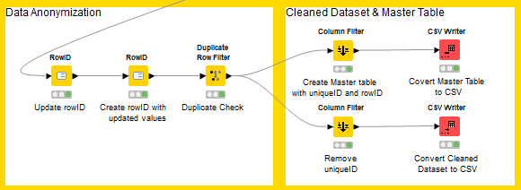
Data Cleaning
Anonymization
Created Master Table to link values
Created Cleaned & Anonymized Dataset for modeling
Update existing generated rowID
Create rowID column
Ensure no duplicates in dataset

Slide 27

04
Model &
Evaluation

Slide 28

Our Algorithms
Decision Tree
Support Vector
Neural Network
Logistic Regression

Slide 29
Feature Selection
Logistic Regression
 | Insignificant / Removed Features | Misclass
All Features | work_type Residence_type ever_married | 0.2140
w/o insignificant features | NIL | 0.2169
Stepwise | work_type, residence_type, ever_married, bmi, gender, heart_disease | 0.2184
Feature Used - All Features & w/o insignificant features

Slide 30
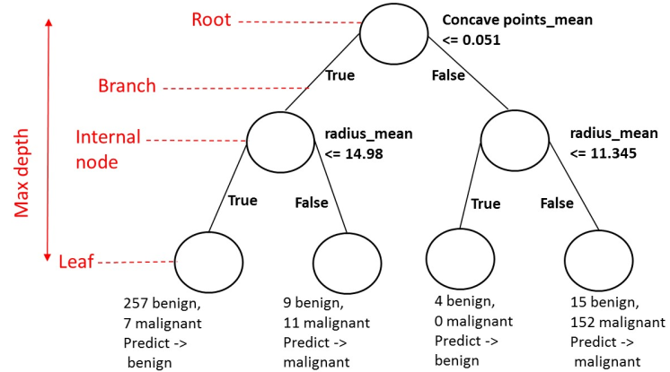
Decision Tree
Tuned Parameters
01 Maximum number of branches
02 Maximum level
amount of criteria used to split node/root
model to have a more in depth analysis.

Slide 31
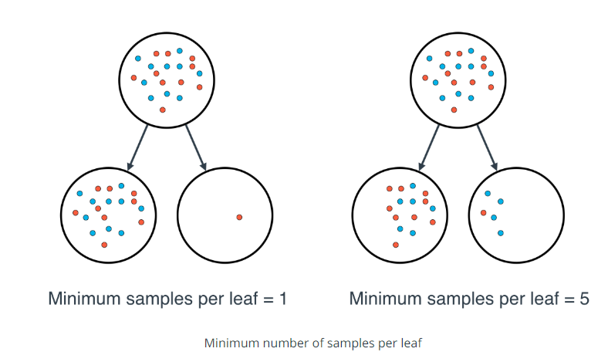
Decision Tree
Tuned Parameters
03 Leaf size
04 Predictor Bin
minimum observations that are allowed in a leaf node
specify the number of bins used to categorize a predictor that is a measure variable

Slide 32
Decision Tree
Tuned comparisons
 | Parameters Tuned | Misclass | ROC | Lift @ 20%
Default | 2 branches, 6 level max 5 Leaf, Predictor Bin - 50 | 0.2103 | 0.5795 | 1.7506
Tuned 1 | 2 branches, 14 level max 1 Leaf, Predictor Bin - 170 | 0.1813 | 0.6434 | 1.6058
Tuned 2 w selected var | 3 branches, 13 level max 1 Leaf, Predictor Bin - 165 | 0.1820 | 0.6360 | 1.7662
Tuned 3 w selected var | 3 branches, 8 level max, 3 Leaf, Predictor Bin - 50 | 0.1939 | 0.6211 | 1.7710
Best Model: Tuned 2 – 3 branches, maximum 13 level, 1 Leaf, 165 predictor bin (81.80% accuracy)

Slide 33
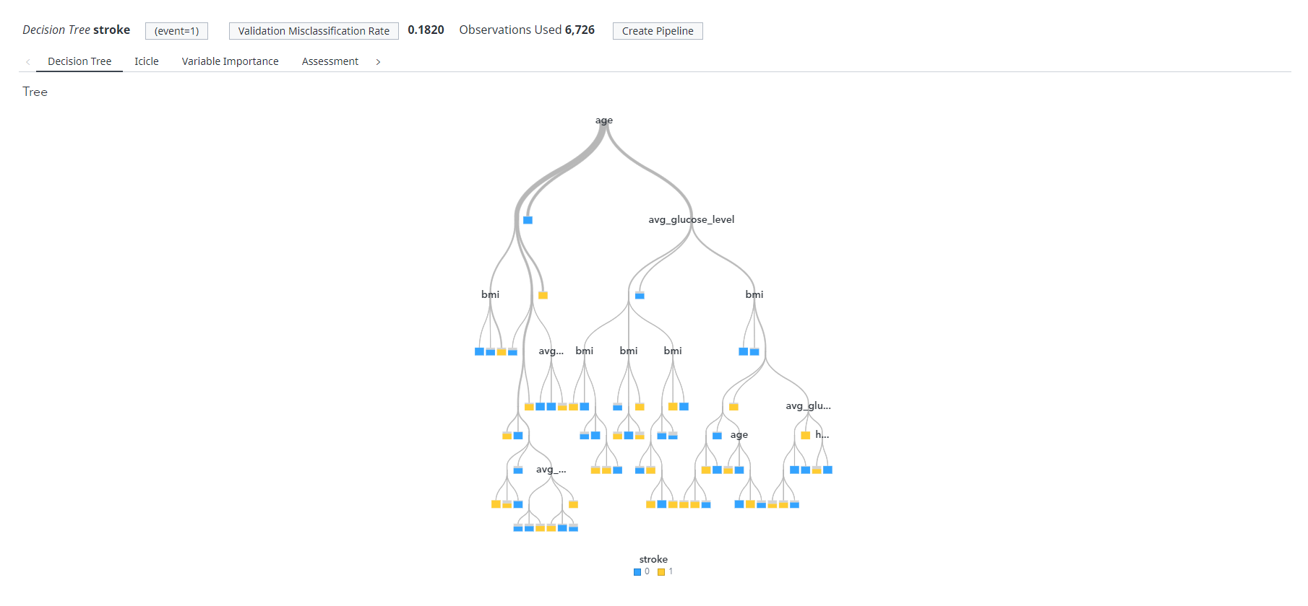
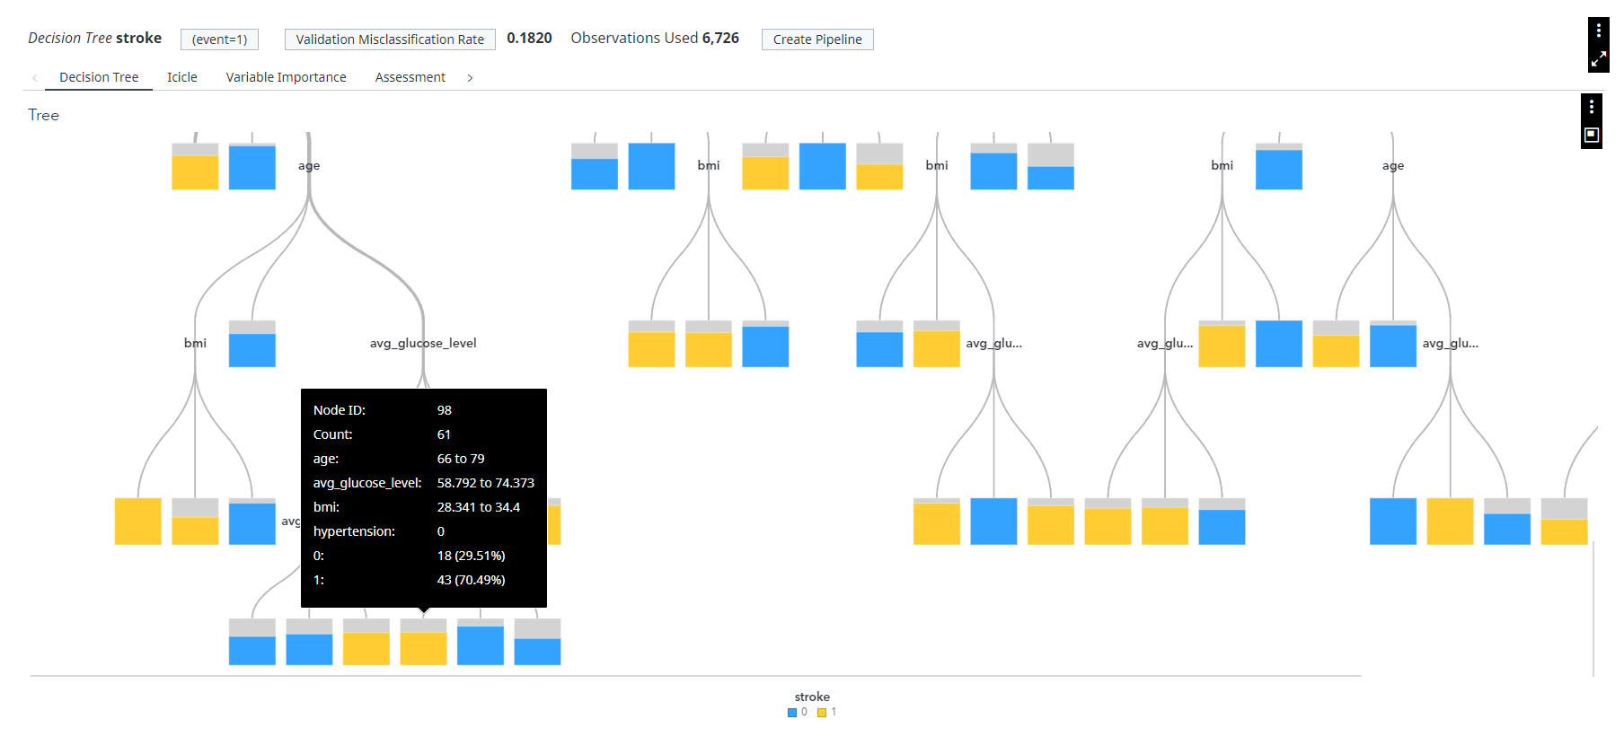
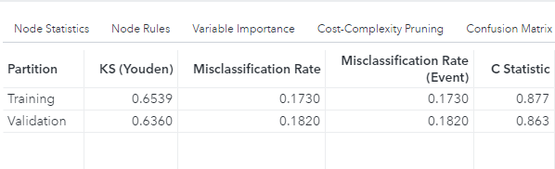
Decision Tree
Rule Split

Slide 34
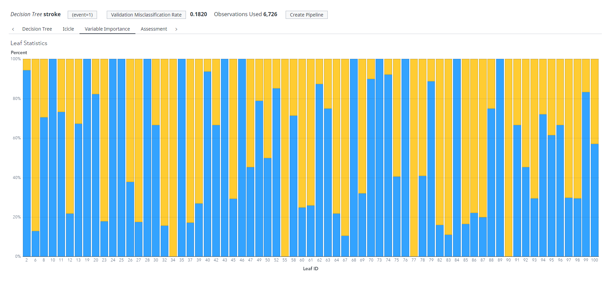
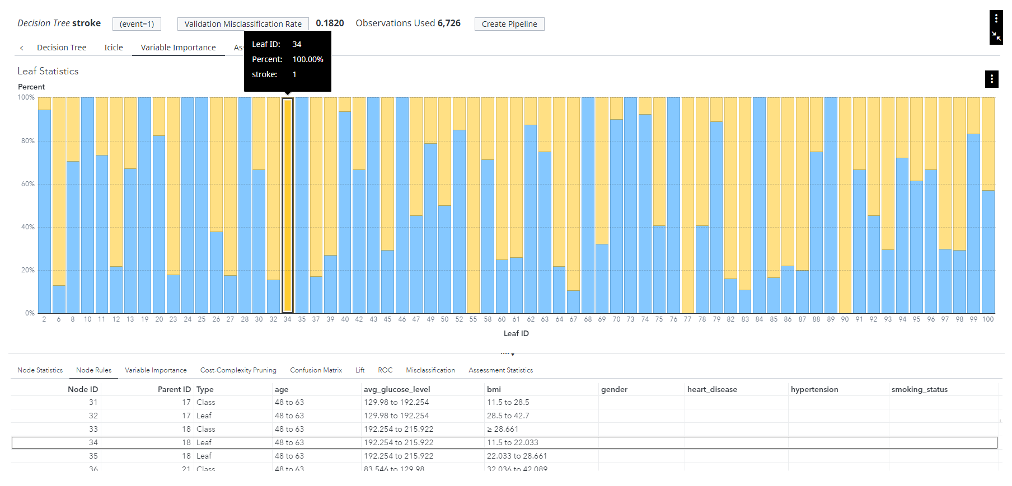
Decision Tree
Leaf Statistic

Slide 35
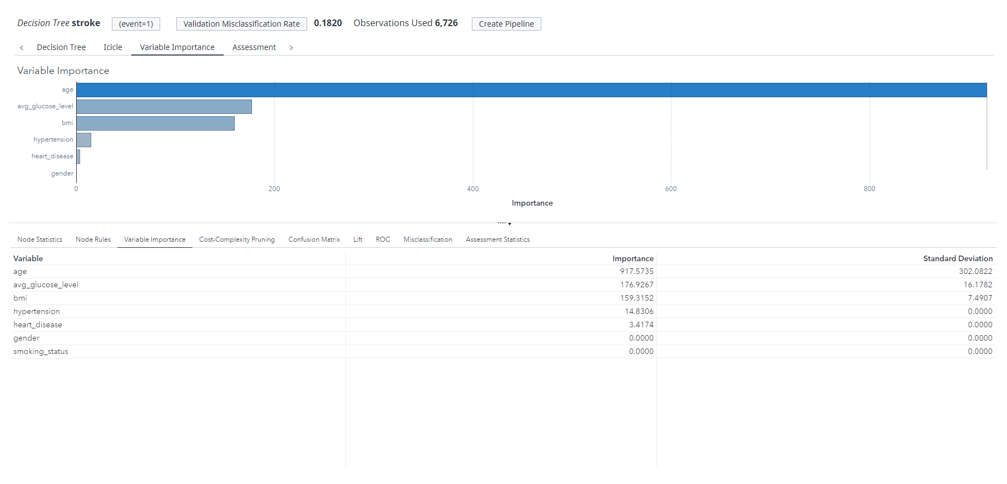
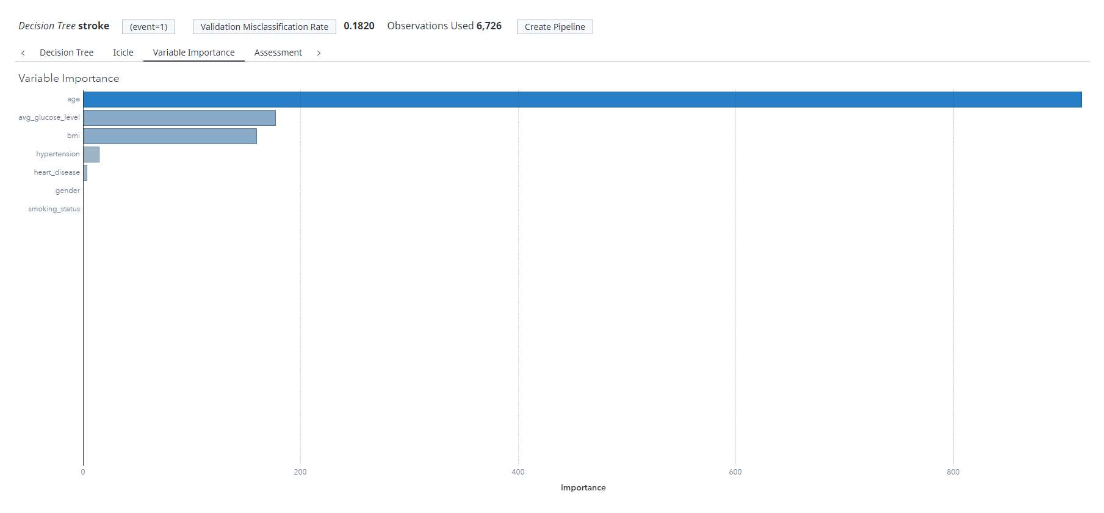
Decision Tree
Variable Importance

Slide 36
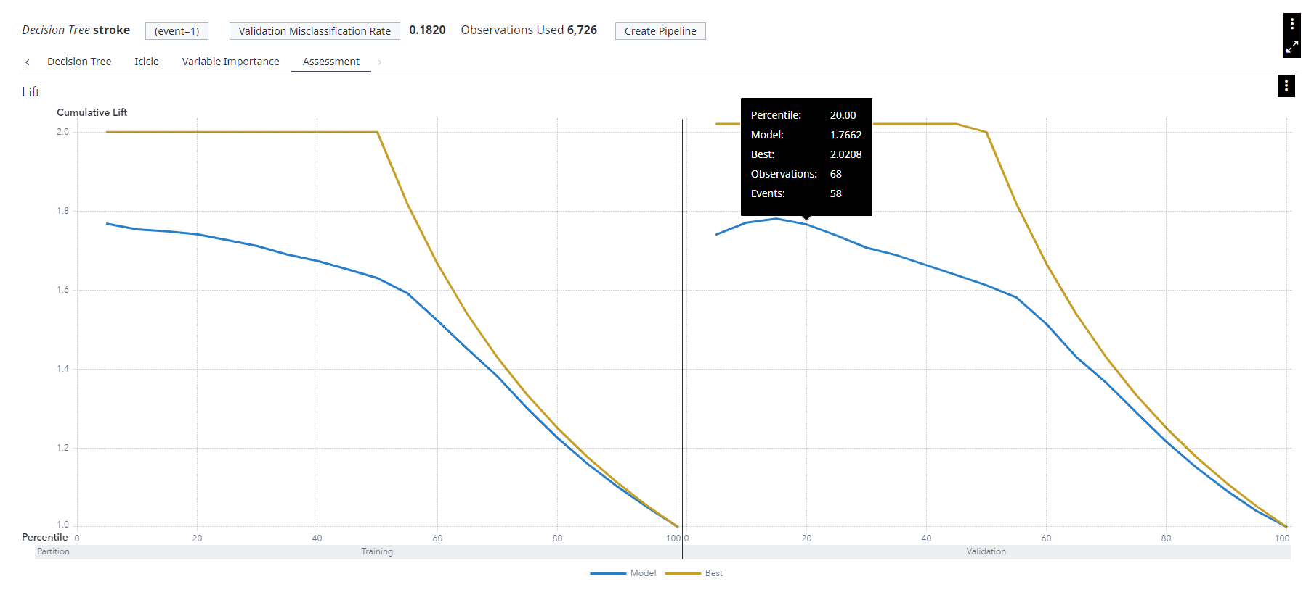
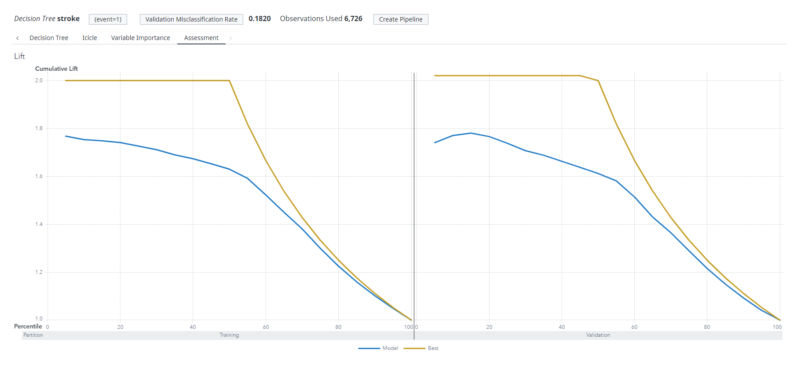
Decision Tree
Lift Chart

Slide 37
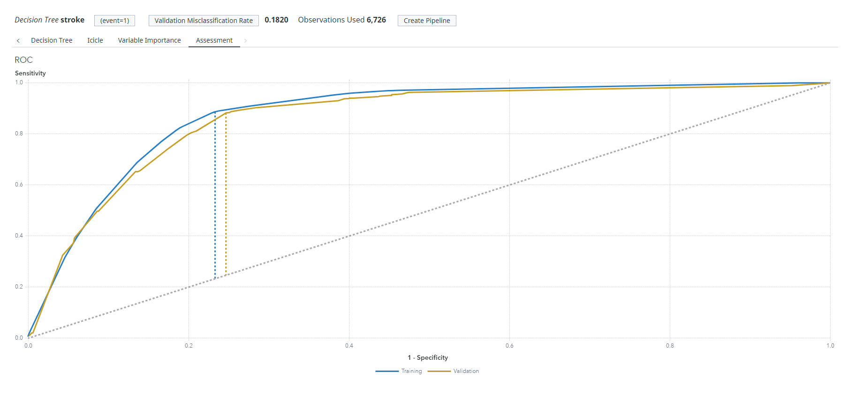
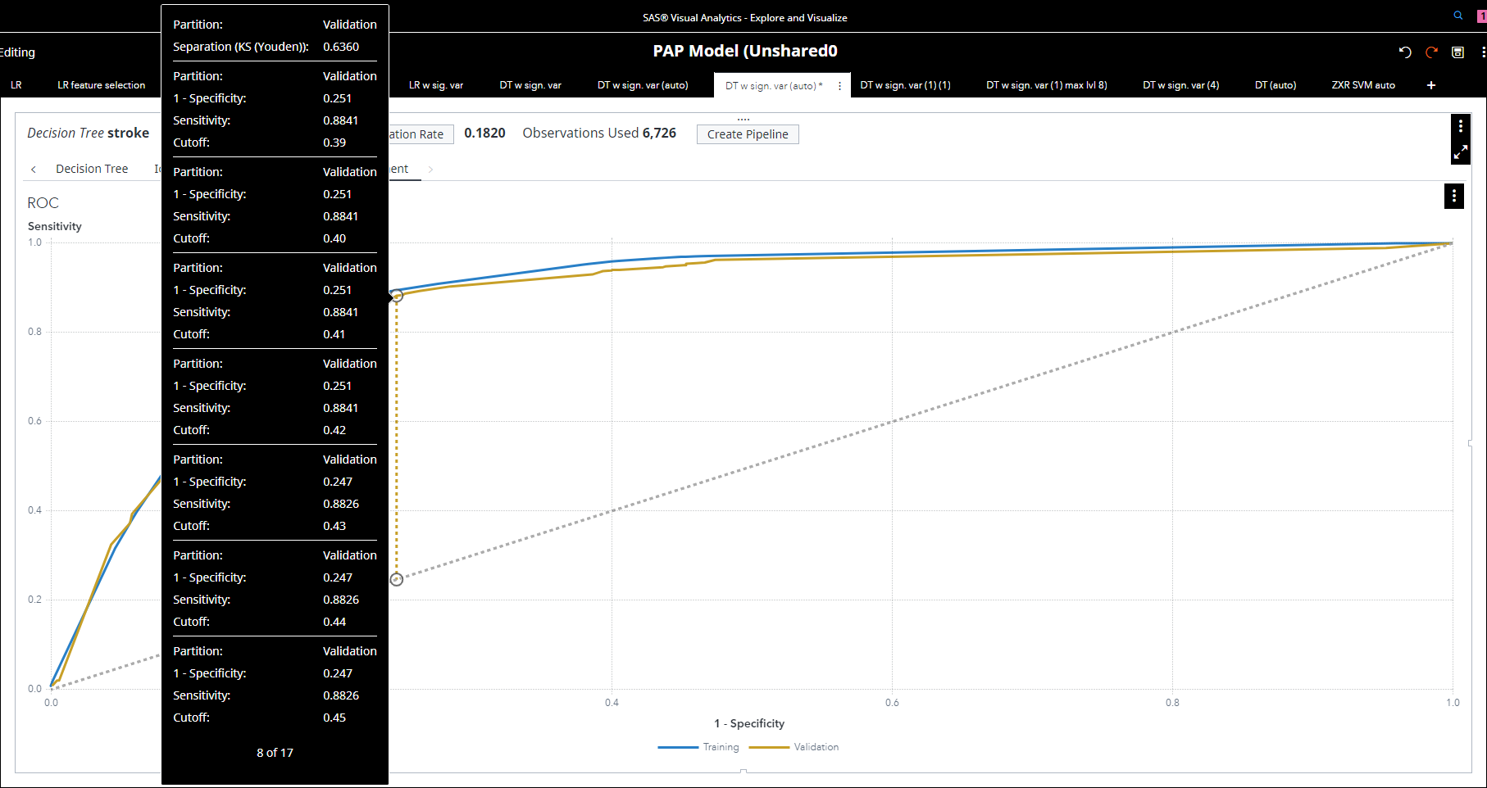
Decision Tree
ROC Curve

Slide 38

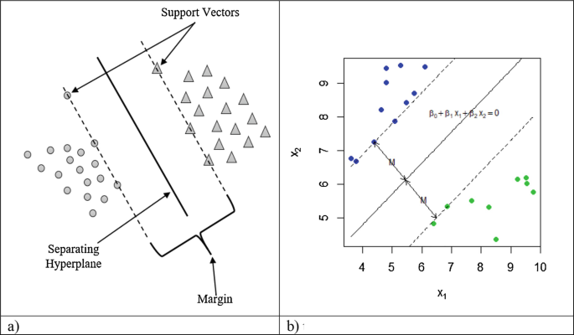
Support Vector Machine
Hyperparameters Tuned
Kernel Function
Penalty Value
↑ Penalty, ↓ margin size
= ↓ misclassification

Slide 39
Support Vector Machine
Tuned comparisons
 | Parameters Tuned | Misclass | ROC | Lift @20%
Default | Kernel: Linear, Penalty Value: 1 | 0.2162 | 0.5721 | 1.6716 / 2.02
Tuned 1 | Kernel: Quadratic Penalty Value: 1 | 0.2006 | 0.6077 | 1.7459 / 2.02
Tuned 2 | Kernel: Cubic, Penalty Value: 86.5 | 0.1783 | 0.6434 | 1.7608 / 2.02
Tuned with Selected Var | Kernel: Cubic, Penalty Value: 77.7 | 0.1991 | 0.6033 | 1.7162 / 2.02
Best Model: Tuned 2 - Cubic Kernel & 86.5 Penalty (82.2% accuracy)

Slide 40
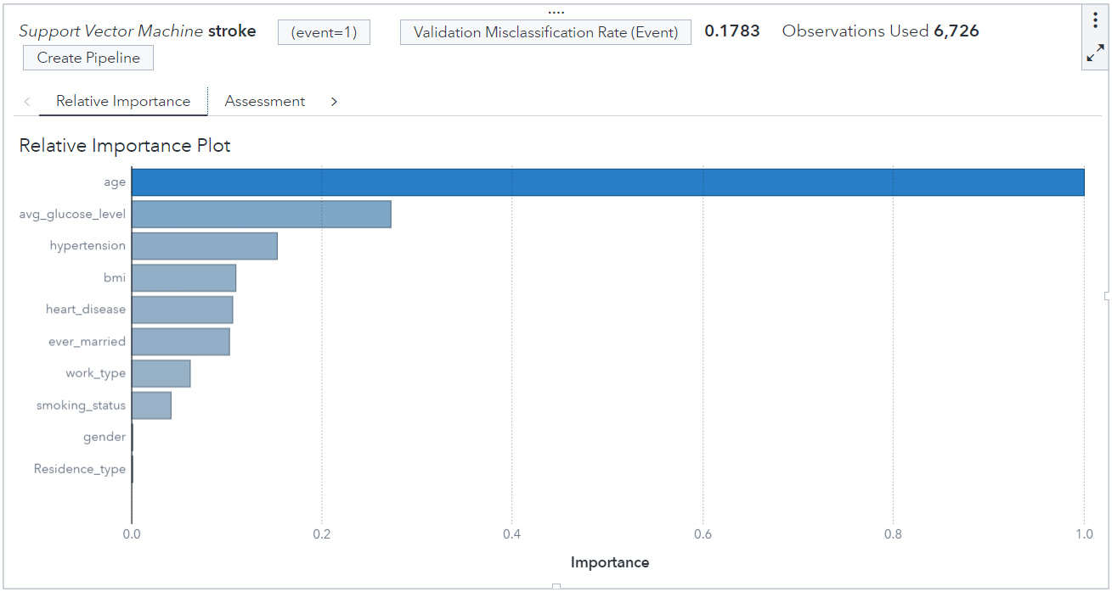
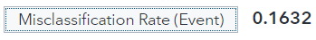
Support Vector Machine
Relative Importance

Slide 41
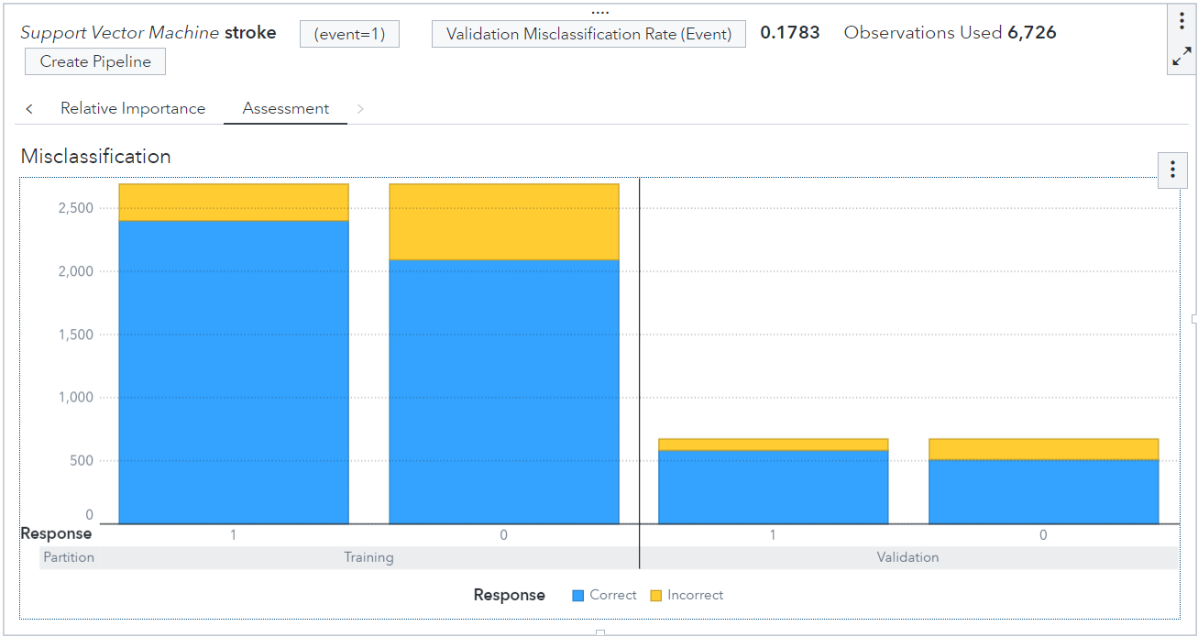
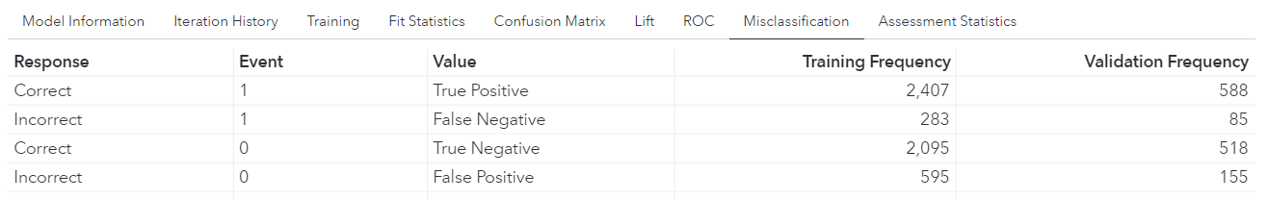
Support Vector Machine
Misclassification
Accuracy (TP+TN/ Total)
= 82.2 %
Sensitivity (TP/ TP + FN)
= 87.4%
Specificity (TN/ TN + FP)
= 80%
Precision (TP/ TP + FP)
= 79.1%

Slide 42
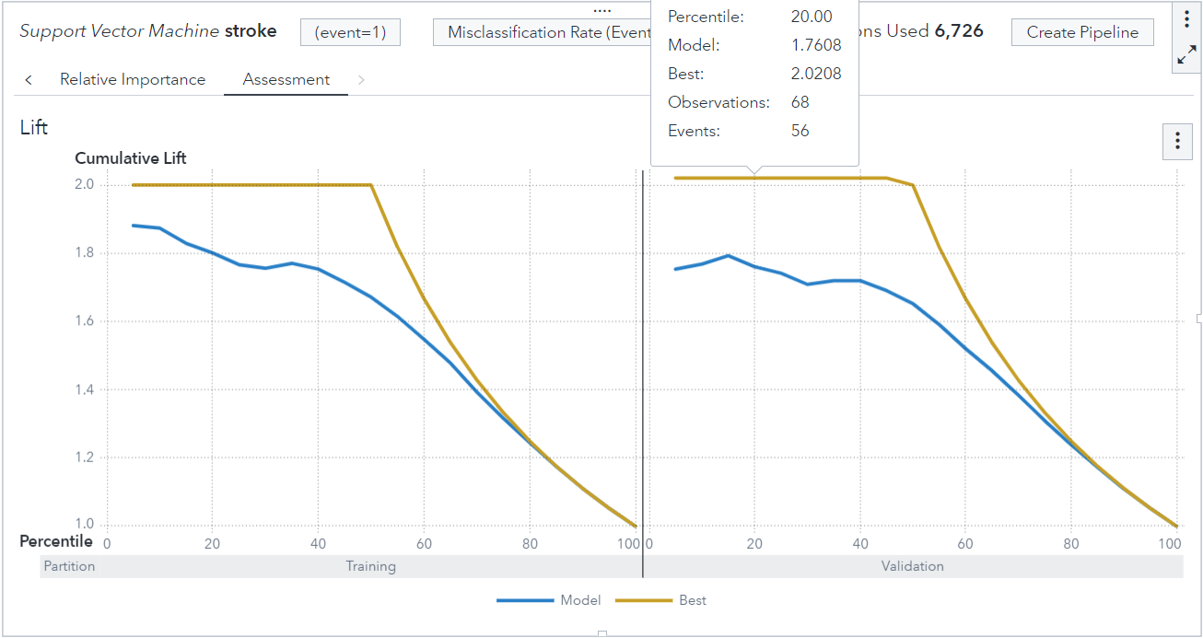
Support Vector Machine
Lift

Slide 43
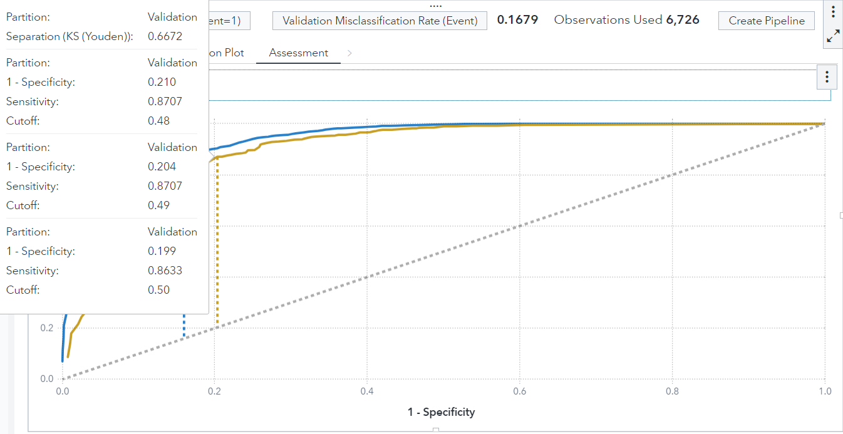
Support Vector Machine
Receiver Operating Characteristic (ROC) curve

Slide 44
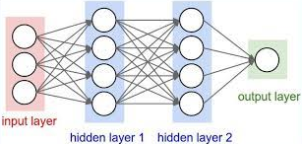
Neural Network
Hyperparameters Tuned
Hidden Layer & Neurons

Slide 45
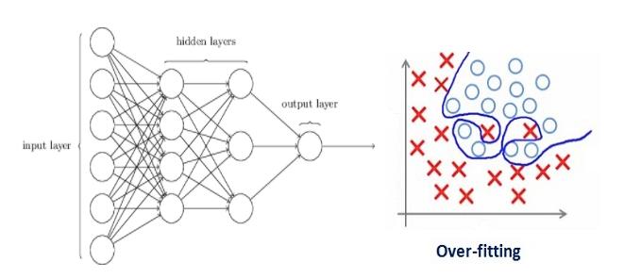
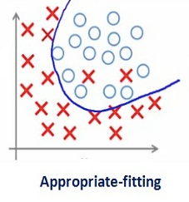
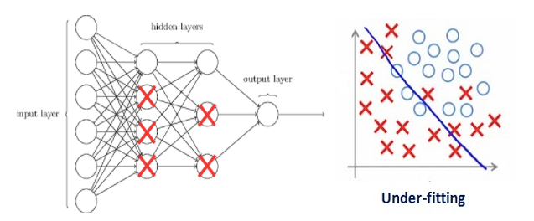
Neural Network
Hyperparameters Tuned
L2 Regularisation

Slide 46

Neural Network
Hyperparameters Tuned
Optimisation method

Slide 47
Neural Network
Tuned comparisons
 | Parameters Tuned | Misclass | ROC | Lift @20%
Default | Hidden Layers: 1, L2: 1 Neurons: 10, Optimisation method: LBFGS | 0.2140 | 0.5795 | 1.6790 / 2.02
Tuned 1 | Hidden Layers: 2, L2: 0.01 Neurons: 20, Optimisation method: SGD | 0.4354 | 0.5988 | 1.7979 / 2.02
Tuned 2 | Hidden Layers: 2, L2: 0.00046 Neurons: 20, 30 | 0.1679 | 0.6672 | 1.7682 / 2.02
Tuned with Selected Var | Hidden Layers: 2, L2: 0.000046 Neurons: 10, 14 | 0.1991 | 0.6033 | 1.7608 / 2.02
Best Model:
Tuned 2 - 2 Hidden Layers, 0.00046 L2,
20 & 30 Neurons (83 .2% accuracy)

Slide 48
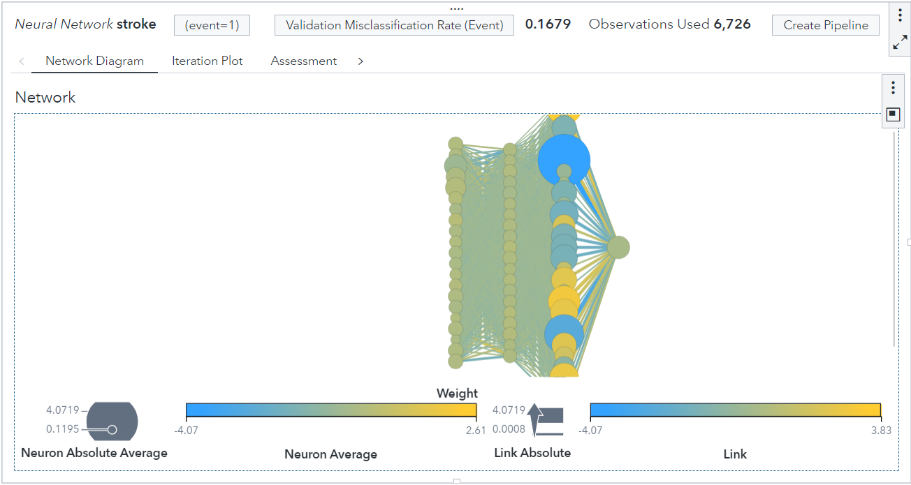
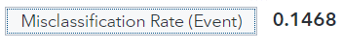
Neural Network

Slide 49
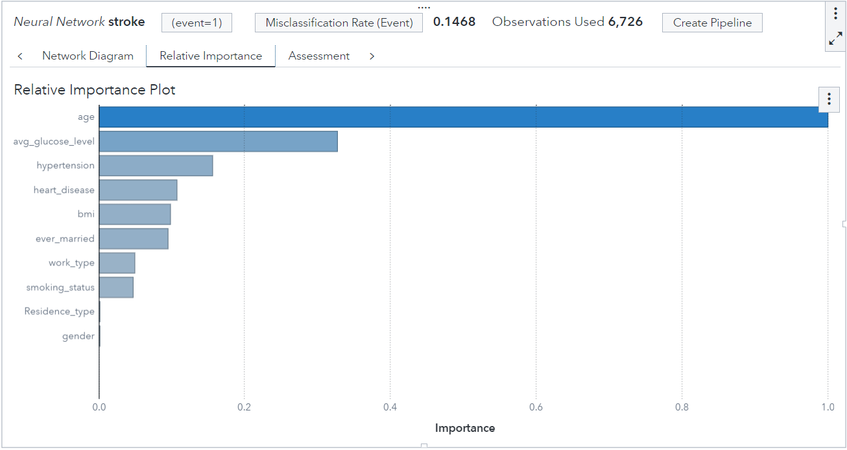
Neural Network
Relative Importance

Slide 50
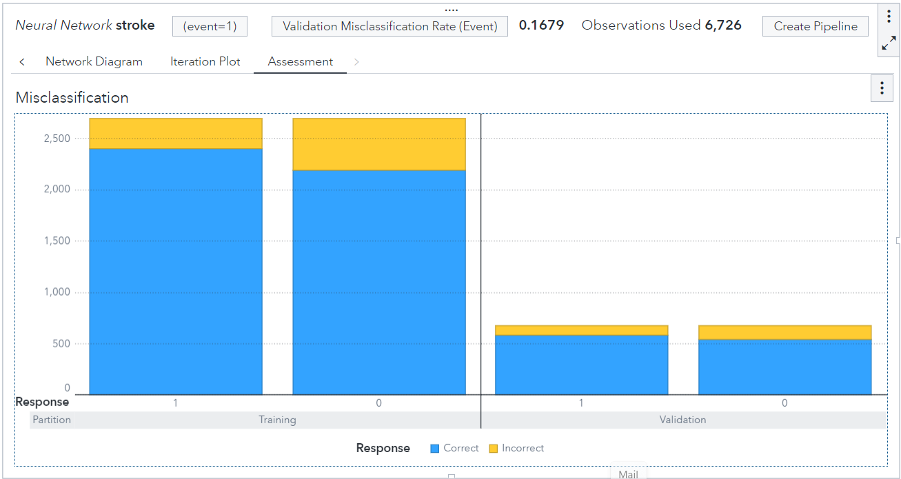
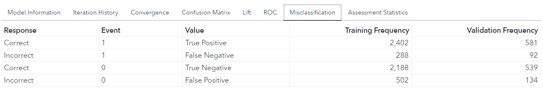
Neural Network
Misclassification
Accuracy (TP+TN/ Total)
= 83.2 %
Sensitivity (TP/ TP + FN)
= 86.3%
Specificity (TN/ TN + FP)
= 80.1%
Precision (TP/ TP + FP)
= 81.3%

Slide 51
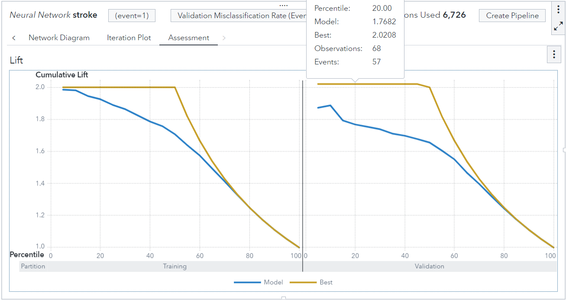
Neural Network

Slide 52
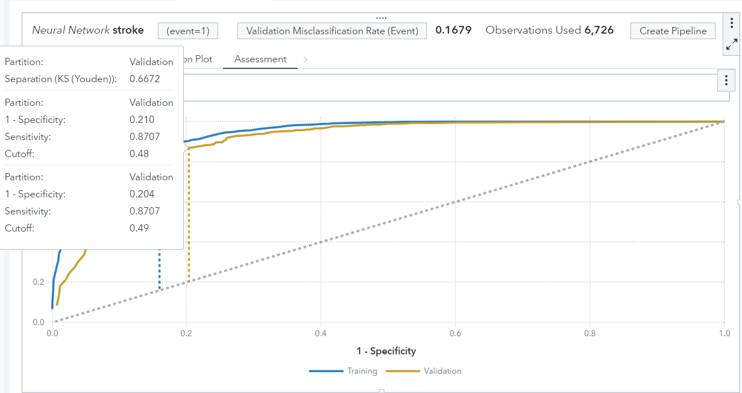
Neural Network
Receiver Operating Characteristic (ROC) curve

Slide 53

Model Comparison & Findings

Slide 54
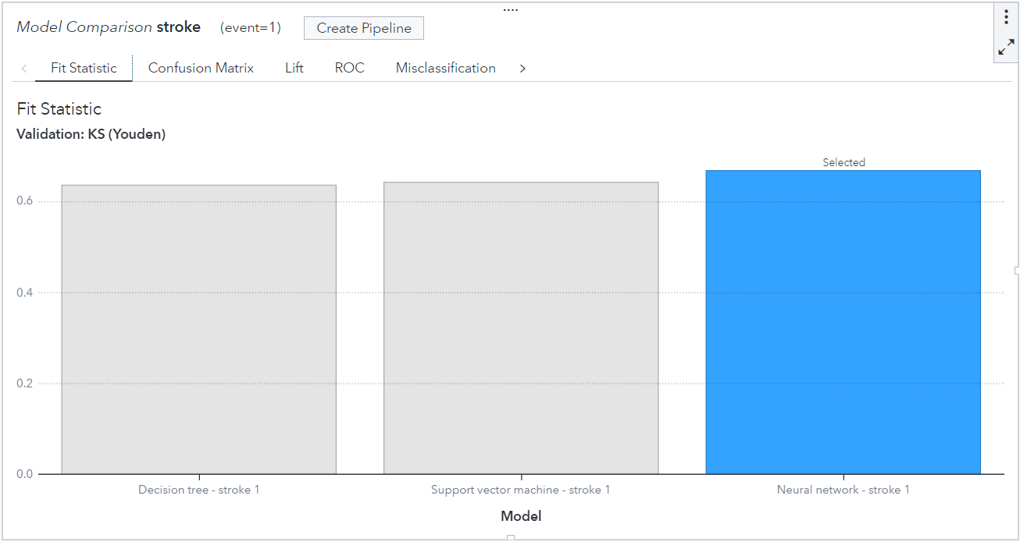
Model Comparison
Selected Model

Slide 55
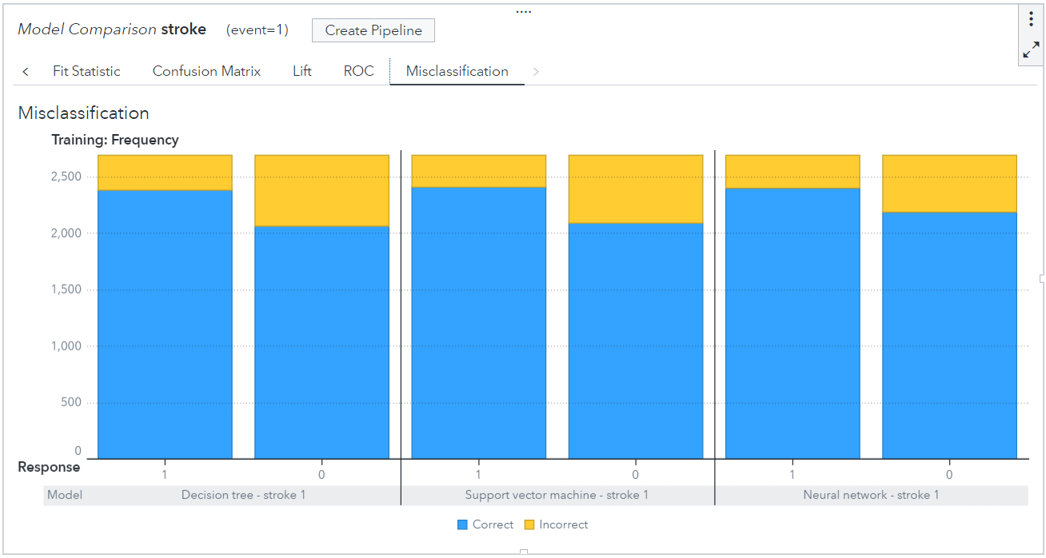
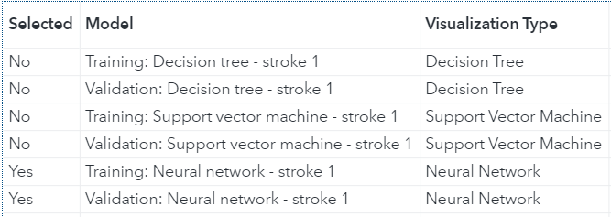

Model Comparison
Misclassification

Slide 56

Model Comparison
Lift

Slide 57

Model Comparison
Receiver Operating Characteristic (ROC) curve

Slide 58


Model Comparison
Relative Importance

Slide 59

Diabetes Prediction

Slide 60

02a
Data Collection

Slide 61
Selected Dataset
An ongoing surveillance system designed to measure behavioural risk factors for the non-institutionalised adult population (aged 18 years of age and older) residing in the United States which is done by Behavioural Risk Factor Surveillance System (BRFSS).
This dataset contains 330 features (columns) and have 441,455 responses. These features are either questions directly asked of participants or calculated variables (unique question name) based on individual participant responses.
Features include cigarette use, HIV/AIDS knowledge and prevention, exercise, immunisation, health status, chronic health conditions, alcohol consumption, fruits and vegetable consumption.

Slide 62

02b
Data Understanding

Slide 63

Data Understanding
Target Variable
There are 6 categories of response made with encoded values of 1-9.
As our prediction result will be a binary result. We only consider encoded value of 1-4, which give an understanding in telling us if surveyees have diabetes or do not have.
Then group them into 2 groups.
Have Diabetes (1 and 2)
Do not have Diabetes (3 and 4)

Slide 64

Data Understanding
Target Variable Unbalance
There are 6 categories of response made with encoded values of 1-9.
As our prediction result will be a binary result. I would consider encoded value of 1-4, which give an understanding of if surveyors have diabetes or not.
Then group them into 2 groups.
Have Diabetes (1 and 2)
Do not have Diabetes (3 and 4)

Slide 65

Data Understanding
Missing Response
Values 7, 9 and Null, are used for response with “Don’t Know/Not Sure” and “Refused”.
Values do not provide any understanding from the responder, will be removed.

Slide 66

Data Understanding
Outlier
In the BMI feature, removal of outliers will be performed in KNIME. Only appropriate inputs in our data will be kept.
E.g. The BMI can go up to above 90. BMI classifier as below:
Under: Below 18.5 Normal: 18.5 to 24.9,
Overweight: 25 to 29.9 Obese: 30 to 39.9++

Slide 67


Data Understanding
Inconsistency in Responses
In the codebook definition a value 1 can represent a “Yes” or “No” response for different variables.
To synchronize the definition, 1 and 2 is changed to 1 and 0, respectively. Where 1 represent a “Yes” and 0 represent a “No” response.

Slide 68

03
Data Cleaning

Slide 69




Data Cleaning
Convert 7 and 9 to Missing + Removal of Missing Value
Remove all rows with “?”, so as to retain rows that are able to tell us a complete story.
Convert 7 & 9 that often represent “Missing”, “Refused” to answer and “Don’t Know” to “?” AKA missing value

Slide 70


Data Cleaning
Balancing

Slide 71



Data Cleaning
Data Transformation
We would like to set values to:
0: False/No
1:True/Yes
Use KNIME’s “Rule Engine” node to change values 2 that are often “No” to value 0.

Slide 72


Data Cleaning
Partitioning

Slide 73

04
Model &
Evaluation

Slide 74
Our Algorithms
Decision Tree
Support Vector
Random Forest
Logistic Regression

Slide 75

Feature Selection
Logistic Regression
Insignificant variables:
Depressive Disorder
Arthritis
Consumption of Fruits

Slide 76
Decision Tree
 | Parameters Tuned | Misclass | ROC | Lift @20%
Default | 2 branches, 6 level max Predictor Bin - 50 | 0.3082 | 0.3835 | 1.5220
Tune 1 | 2 branches, 9 level max Predictor Bin - 82 | 0.3034 | 0.3957 | 1.5751
Tune 2 | 3 branches, 13 level max Predictor Bin - 82 | 0.3070 | 0.3860 | 1.5431
Variable Selection P< 0.05 | 2 branches, 13 level max Predictor Bin - 138 | 0.3022 | 0.3959 | 1.5037
Best Model: Tuned 2 Branches & 13 Maximum max 138 Predictor Bin with removal of insignificant variable (69.78% accuracy)

Slide 77

Model
Decision Tree Variable Importance
Notes:
Insignificant variable with p value < 0.05 is removed

Slide 78

Model
Decision Tree

Slide 79



Model
Decision Tree
Group Without High Blood Pressure
Node 3 and 4
13026 Records
Group With High Blood Pressure
Node 5 and 6
18490 Records

Slide 80


Model
Decision Tree Leaf Diagram

Slide 81

Model
Decision Tree ROC
Notes:
Insignificant variable with p value < 0.05 is removed

Slide 82

Model
Decision Tree Lift
Notes:
Insignificant variable with p value < 0.05 is removed

Slide 83


Support Vector Machine
Overfitted
Generalized

Slide 84

Support Vector Machine
Hyperparameter

Slide 85
Support Vector Machine
 | Parameters Tuned | Misclass | ROC | Lift @20%
Default | Kernel: Linear, Penalty Value: 1 | 0.3039 | 0.3967 | 1.6244
Tune 1 | Kernel: Quadratic, Penalty Value: 2 | 0.3022 | 0.3990 | 1.6125
Tune 2 | Kernel: Quadratic, Penalty Value: 88.8 | 0.3016 | 0.3997 | 1.6116
Variable Selection P< 0.05 | Kernel: Quadratic, Penalty Value: 2 | 0.3015 | 0.4020 | 1.6090
Best Model: Tuned Quadratic Kernel & 2 Penalty with removal of insignificant variable (69.85% accuracy)

Slide 86

Model
Support Vector Machine Variable Importance

Slide 87

Model
Support Vector Machine ROC

Slide 88

Model
Support Vector Machine ROC

Slide 89

Model
Support Vector Machine Lift

Slide 90

Model
Support Vector Machine Misclassification

Slide 91
Logistic Regression
 | Parameters Tuned | Misclass | ROC | Lift
Default | - | 0.2952 | 0.4165 | 1.625
Tune 1 | Variable Selection P< 0.05 | 0.2923 | 0.4157 | 1.6282
Tune 2 | Forward/backward selection (SBC), Prediction Cutoff =0.52 | 0.2938 | 0.4124 | 1.626
Best Model: By excluding variables with p-value more than 0.05 (70.77% accuracy)

Slide 92

Model
Logistic Regression
Notes:
Insignificant variable with p value < 0.05 is removed

Slide 93

Model
Logistic Regression Lift
Notes:
Insignificant variable with p value < 0.05 is removed

Slide 94

Model
Logistic Regression ROC
Notes:
Insignificant variable with p value < 0.05 is removed

Slide 95
Random Forest
 | Parameters Tuned | Misclass | ROC | Lift
Default | No.of trees =100, Bootstrap=0.6 Predictor split nodes:5 Predictor bins:50 Leaf Size:1 Max Level :6 | 0.3088 | 0.3845 | 1.604
Tune 1 (Best Model) | No.of trees =100, Bootstrap=0.5 Predictor split nodes:7 Predictor bins:80 Leaf Size:20 Max Level :30 | 0.2956 | 0.4114 | 1.6179
Tune 2 | No.of trees =100, Bootstrap=0.7 Predictor split nodes:7, Max Level :30, Leaf Size:20 Predictor bins:80 | 0.2967 | 0.4099 | 1.6048
Best Model: No.of trees=100, Bootstrap=0.7,Predictor split nodes:7, Predictor bins:80, Leaf Size:20, Max Level:30(70.33% accuracy)

Slide 96

Model
Random Forest Variable Importance

Slide 97

Model
Random Forest Lift

Slide 98

Model
Random Forest ROC

Slide 99

Model Comparison & Findings

Slide 100

Model Comparison

Slide 101
Model Comparison

Slide 102

Conclusion

Slide 103

Key Features
Age
Hypertension
The older a person, the higher the chances of getting common health diseases
The higher the blood pressure of an individual, the more prone they are to health problems
BMI
The higher the BMI of an individual, the higher the chances of common health diseases

Slide 104

THANK YOU
For your Attention :)

